Slide 1
HallyuGo✈️
Map App for K-culture Lover
Capstone Design Project Team F
Kim Jisu, Lee Yoojin, Jung Daegyo, Jose Antunes

Slide 2
Table of Contents
01
02
03
04
04
Milestone
Implementation: Frontend
Dataset
Implementation : Backend
Plans
Notes:
그냥 임시로 해 놓은거라 맘대로 수정해도 됩니다…! -대교-

Slide 3
1
Milestone

Slide 4
Milestone
Weeks | 2 - 3 | 4 - 5 | 6 - 7 | 8 - 9 | 10 - 11 | 12 - 13 | 14 - 15
Refinement of Topic
UI & UX Design
DB Design
Implementation
Data Collection
Testing & Deployment

Slide 5
Schedule
Name | Role
Daegyo | User side API implementation, AWS settings
YooJin | Sign In & Sign Up implementation, Auth & fetch settings
Jose | My page implementation, Dataset collection
Jisu | User side API implementation, Tests refactoring

Slide 6
2
Frontend

Slide 7
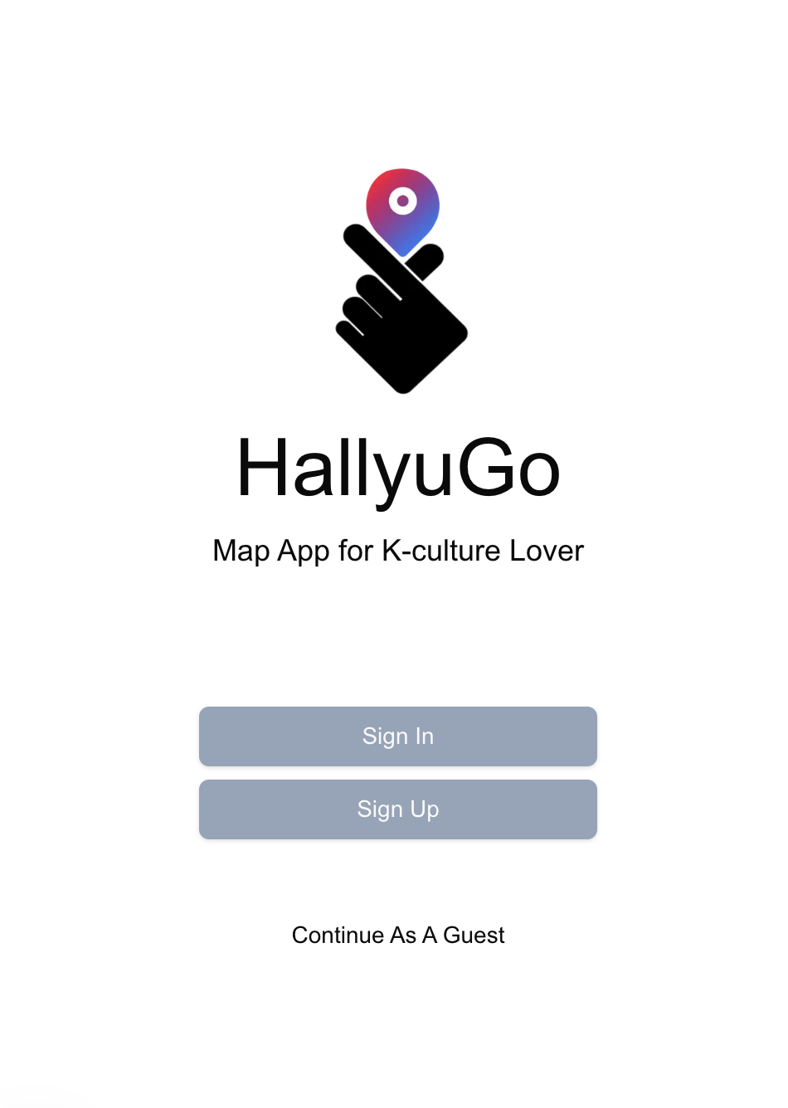
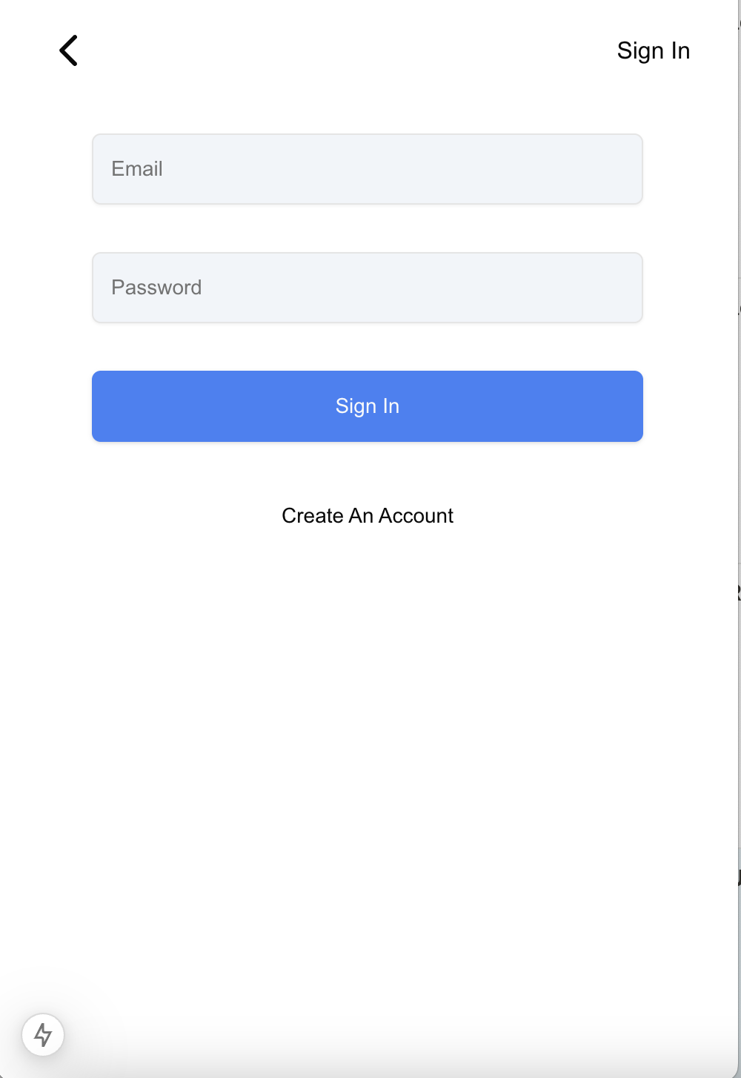
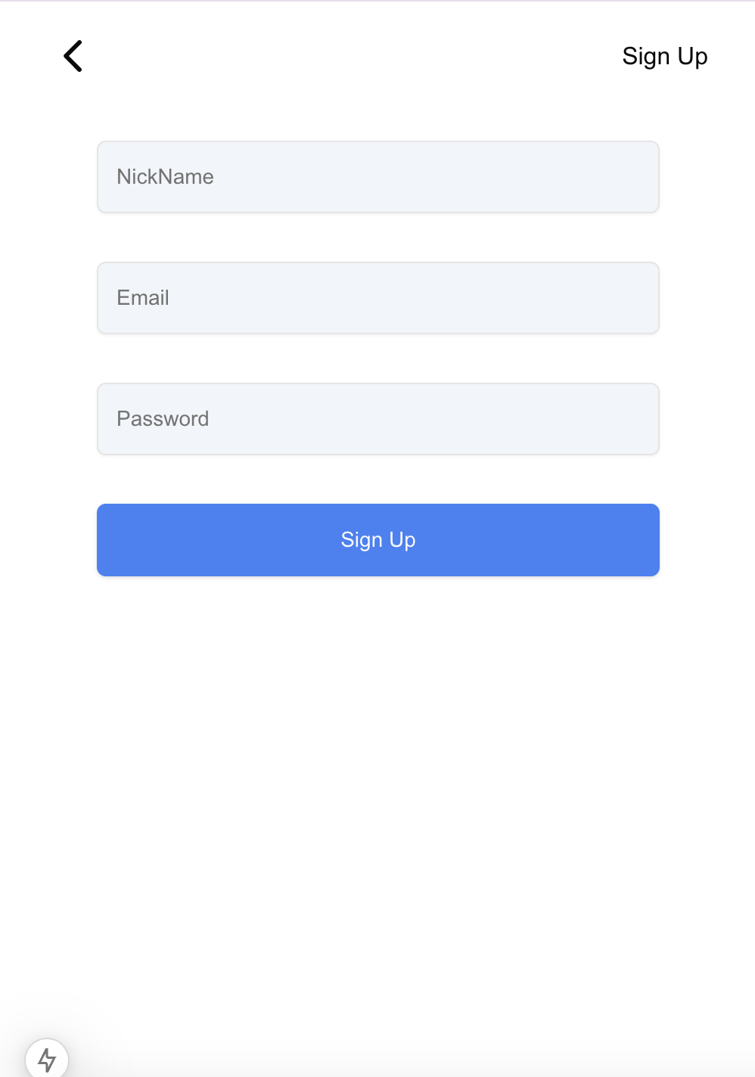
UI: Landing Page, Sign In, Sign Up
Notes:
Landing page -> user can access to the Sign in, Sign up page and can also continue as a guest.
SignIn page -> user can logged in with their own email and password
SignUp Page -> user can sign up with the nickname, email and password

Slide 8
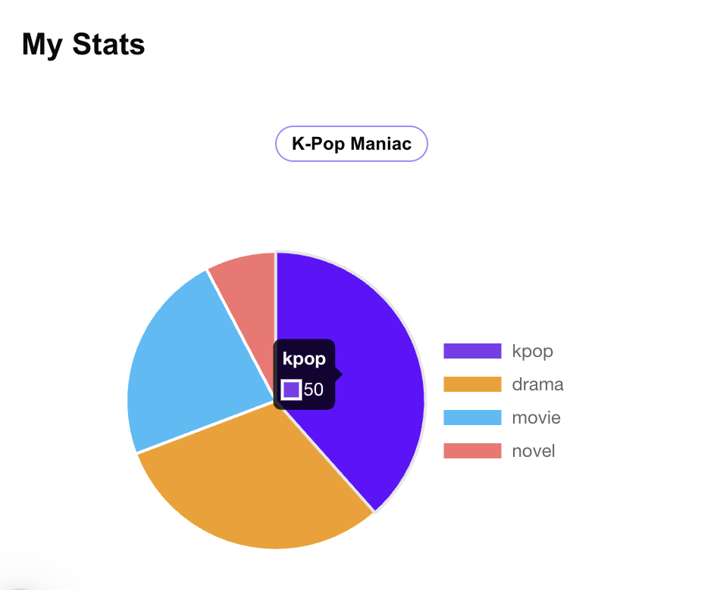
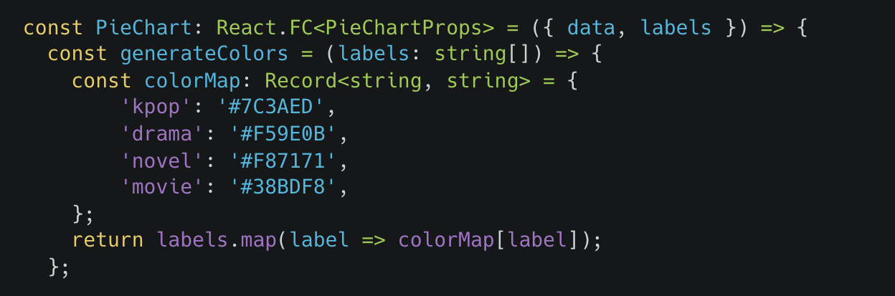
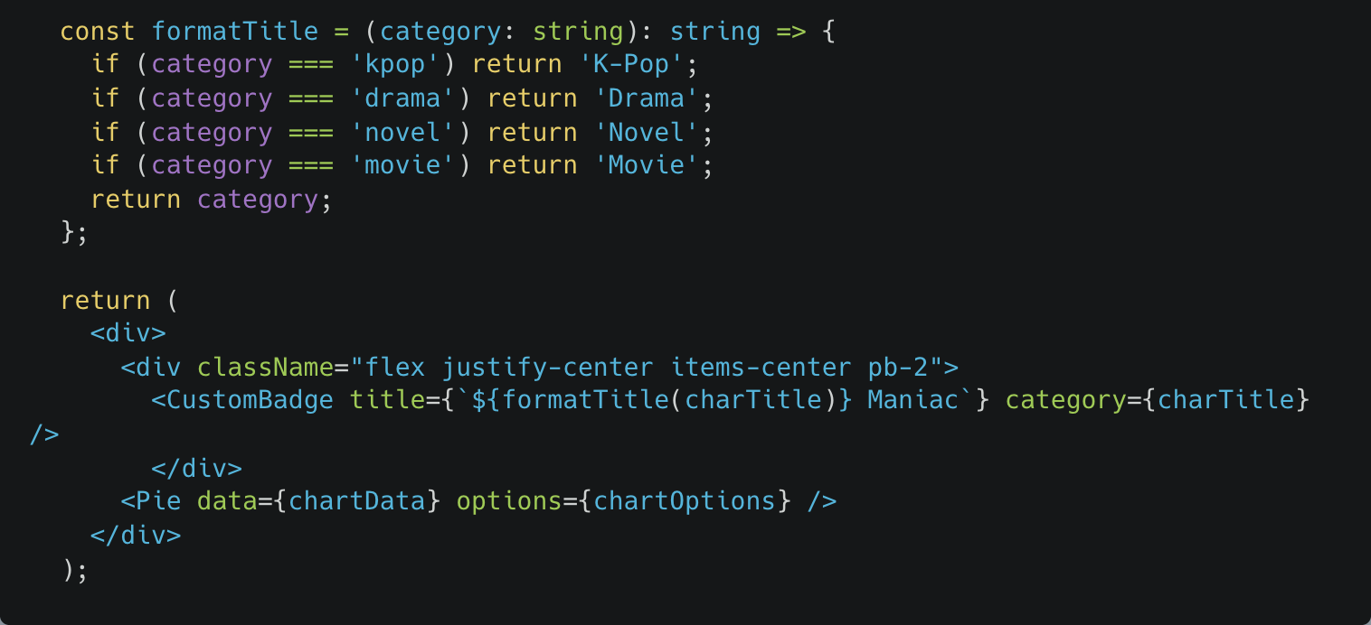
UI: My Stats in My Page
Notes:
Explain yours..!

Slide 9
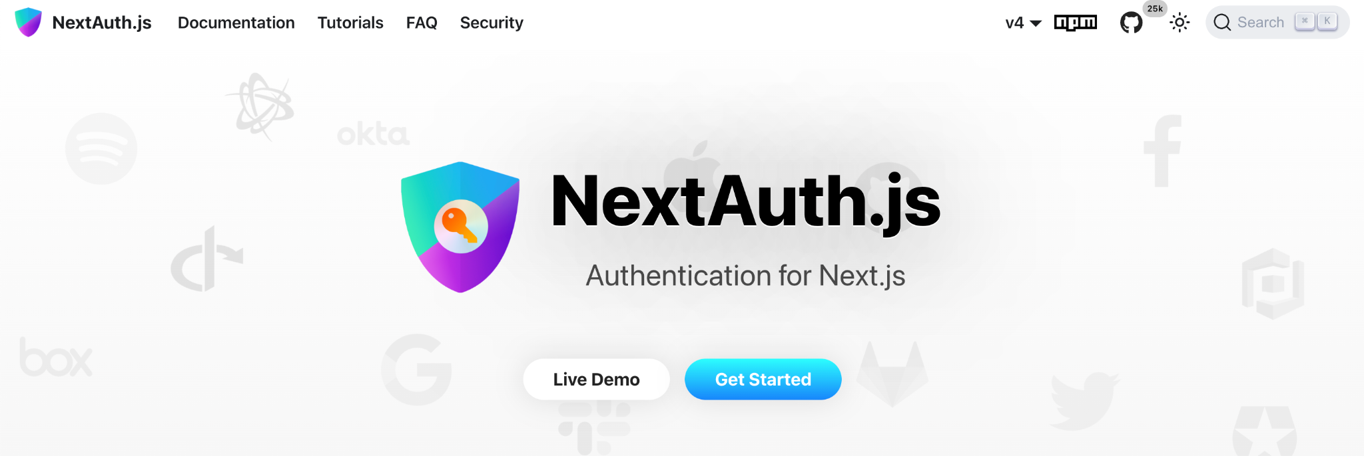
Auth: NextAuth.js
1️⃣ Secure session management
: Using JWT(Json Web Token) for stateless auth
2️⃣ Customizable
: Highly configurable auth logic, callbacks, behavior
Notes:
NextAuth.js is a dedicated authentication solution for Next.js
It allows to quickly and easily implement authentication in applications.
This library provides official support for various login methods, including OAuth providers like Google, and even custom providers.
–
NextAuth.js uses JWT for stateless authentication. it automatically handles token expiration and refresh processes, reducing the need for manual intervention.
Customizable Features
One of the biggest advantages of NextAuth.js is its flexibility. Highly customize the authentication logic, callbacks, and behavior to the project.

Slide 10
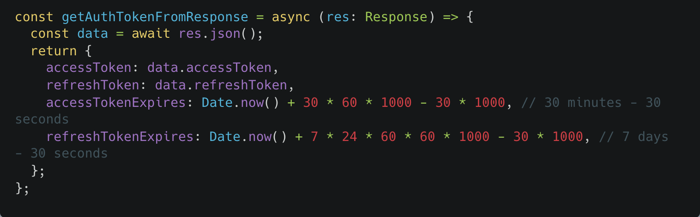
Auth: NextAuth.js
getAuthTokenFromJson()
1️⃣ Parse accessToken & refreshToken from response
2️⃣ Set expirations of accessToken & refreshToken
Notes:
Explain about the Get Auth Token From Json function.
This function parses accessToken, refreshToken from the backend response
And It sets accessTokenExpires and refreshTokenExpires with the current time.
The access token has an expiration time of 30 minutes, and the refresh token is valid for 7 days

Slide 11
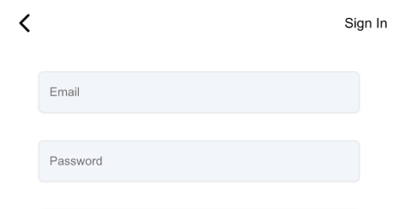
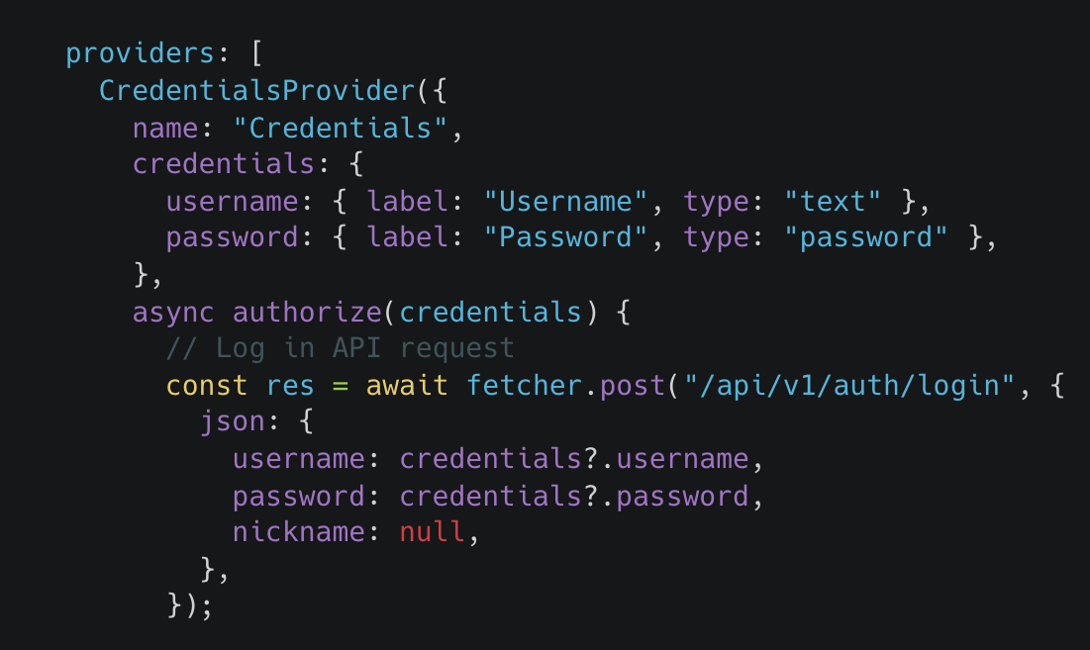
Auth: NextAuth.js
Set CredentialsProvider options as Sign In form
Notes:
Define a CredentialsProvider where the credentials object specifies the required fields for login, such as username and password.
When a user submits the form, these credentials are passed to the authorize function.
And if the response returns ok, then call the getAuthTokenFromJson functions, that explained previous slide

Slide 12
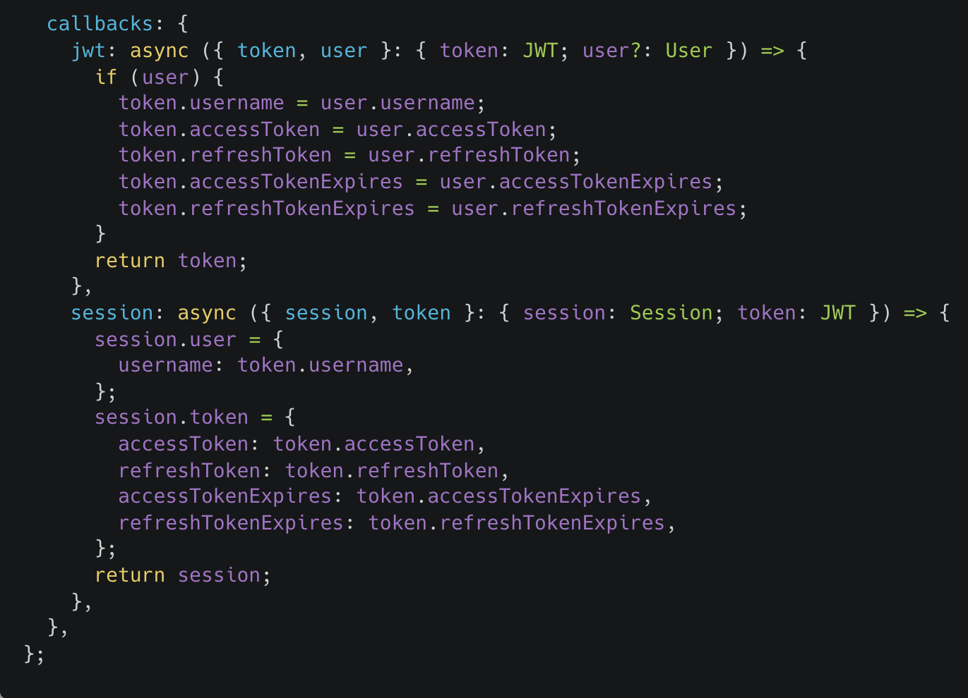
Auth: NextAuth.js
1️⃣JWT Callback
: Update or Refresh JWT
2️⃣Session Callback
: Convert JWT into
session object
Notes:
Callback part - jwt callback, session callback
JWT call back - ensures that every JWT carries all necessary information for the session without requiring frequent server checks.
updates the JWT with user data or refreshes it when needed.
Session Callback
converting the JWT into a session object that the client can easily use.
In the code, we add the user’s username and token data to the session object.
(This ensures that the client has access to all relevant information while maintaining security and efficiency.)

Slide 13
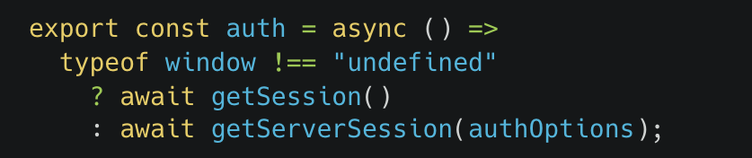
Auth: NextAuth.js
The window object exists only in client-side environment
1️⃣getSession()
: Retrieve session on client-side
2️⃣getServerSession()
: Retrieve session on server-side
Notes:
The window object exists only in the browser, client-side environment.
So check the window has defined, and if it returns true,
call the getSession() function that retrieves the session on the client side.
But when it returns undefined, that it means the environment is server-side, so call the getServerSession function.

Slide 14
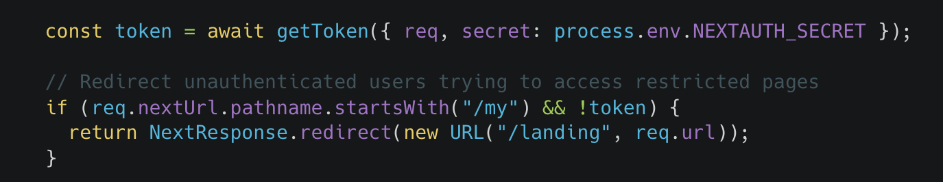
Auth: middleware.ts
Redirect path when unauthorized users try to access My Page
Notes:
We set up the middleware.
In the nextjs, we can handle the apis, redirects, tokens and other things more easily with the middleware file.
The middleware redirects the path to the landing page, when an unauthorized user ties to access the “My” page, which needs the login.

Slide 15
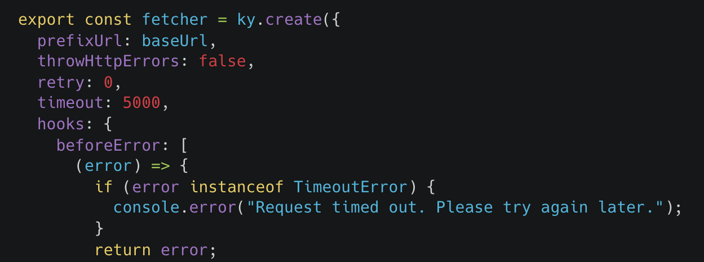
Fetcher: ky fetcher
ky fetcher has powerful hook system
Notes:
And then, we customized the fetcher.
We use the ky fetcher library due to its powerful hook system.
We can separate the fetcher function which can be used without session and fetcherWithAuth function which needs session. (next page)

Slide 16
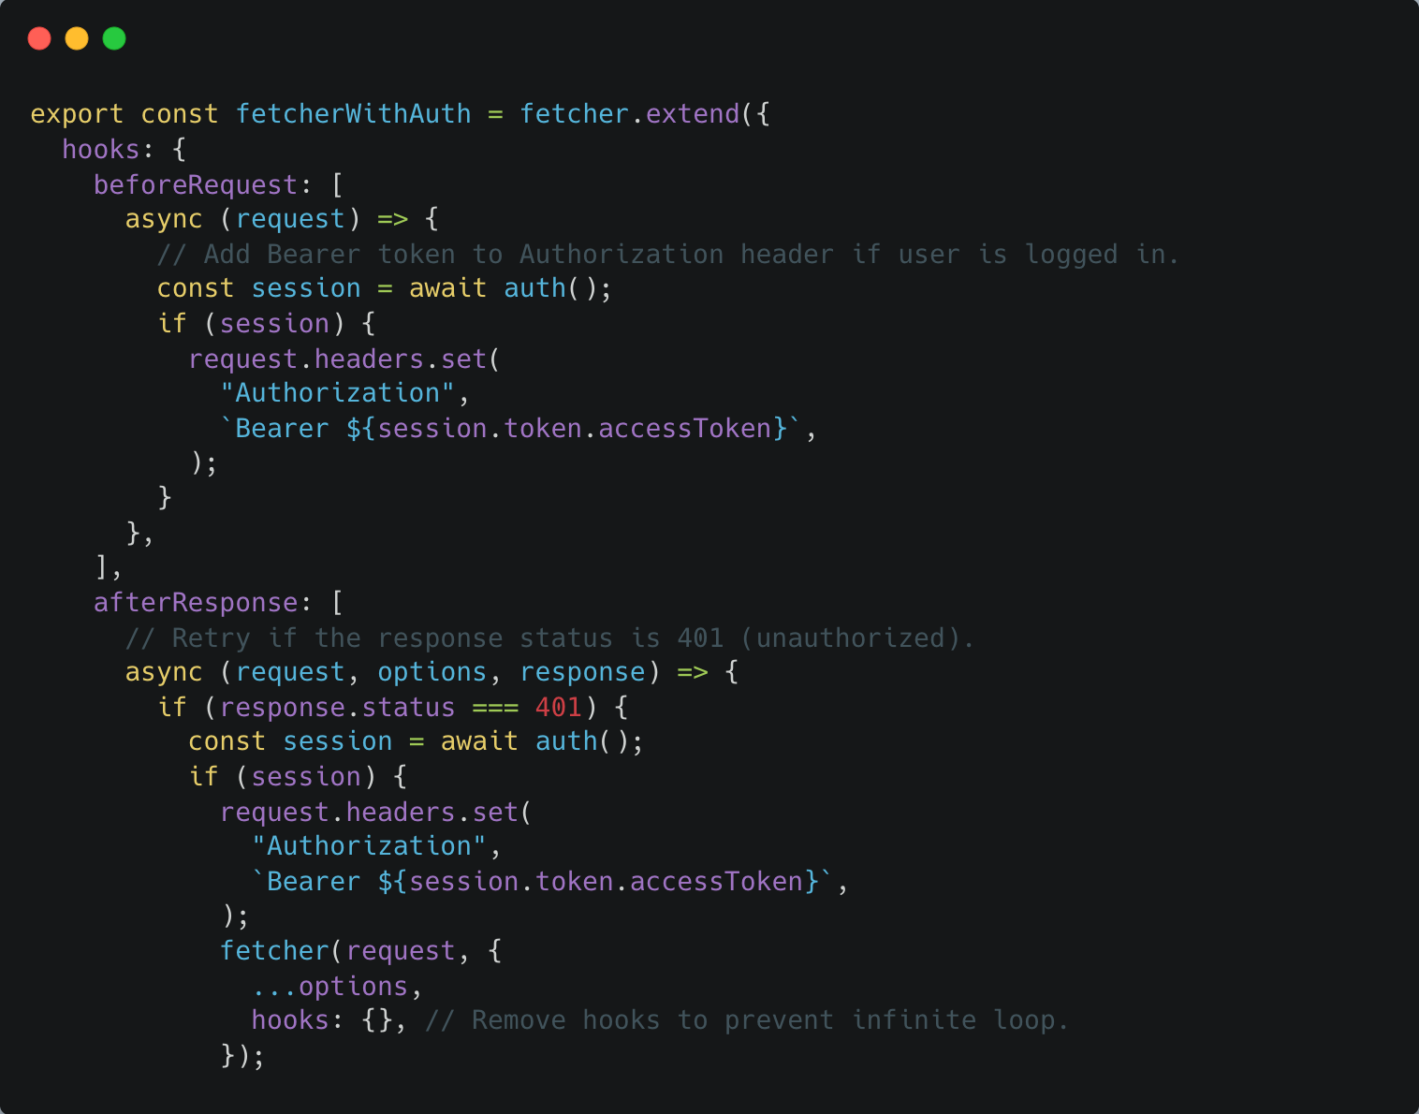
Fetcher: fetcherWithAuth
Request to API
with session
Notes:
This is the FetcherWithAuth function.
This function makes a request to the API with a session. We can use this function to fetch APIs that require the user's data, such as "My Page" APIs.
If a session exists, it sets the Authorization header with the Bearer token.
This allows the backend to recognize that the request is authorized.

Slide 17
3
Dataset

Slide 18
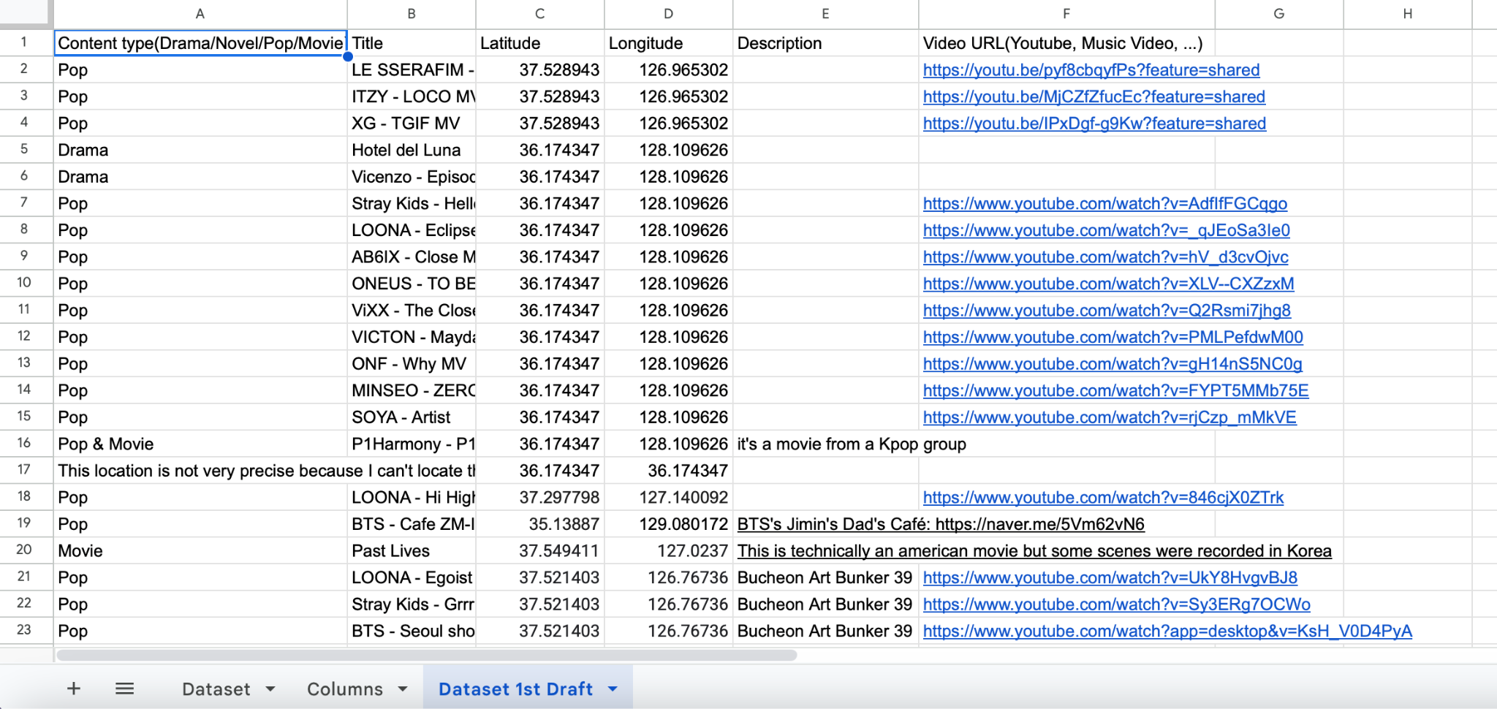
Dataset: 1st Draft

Slide 19
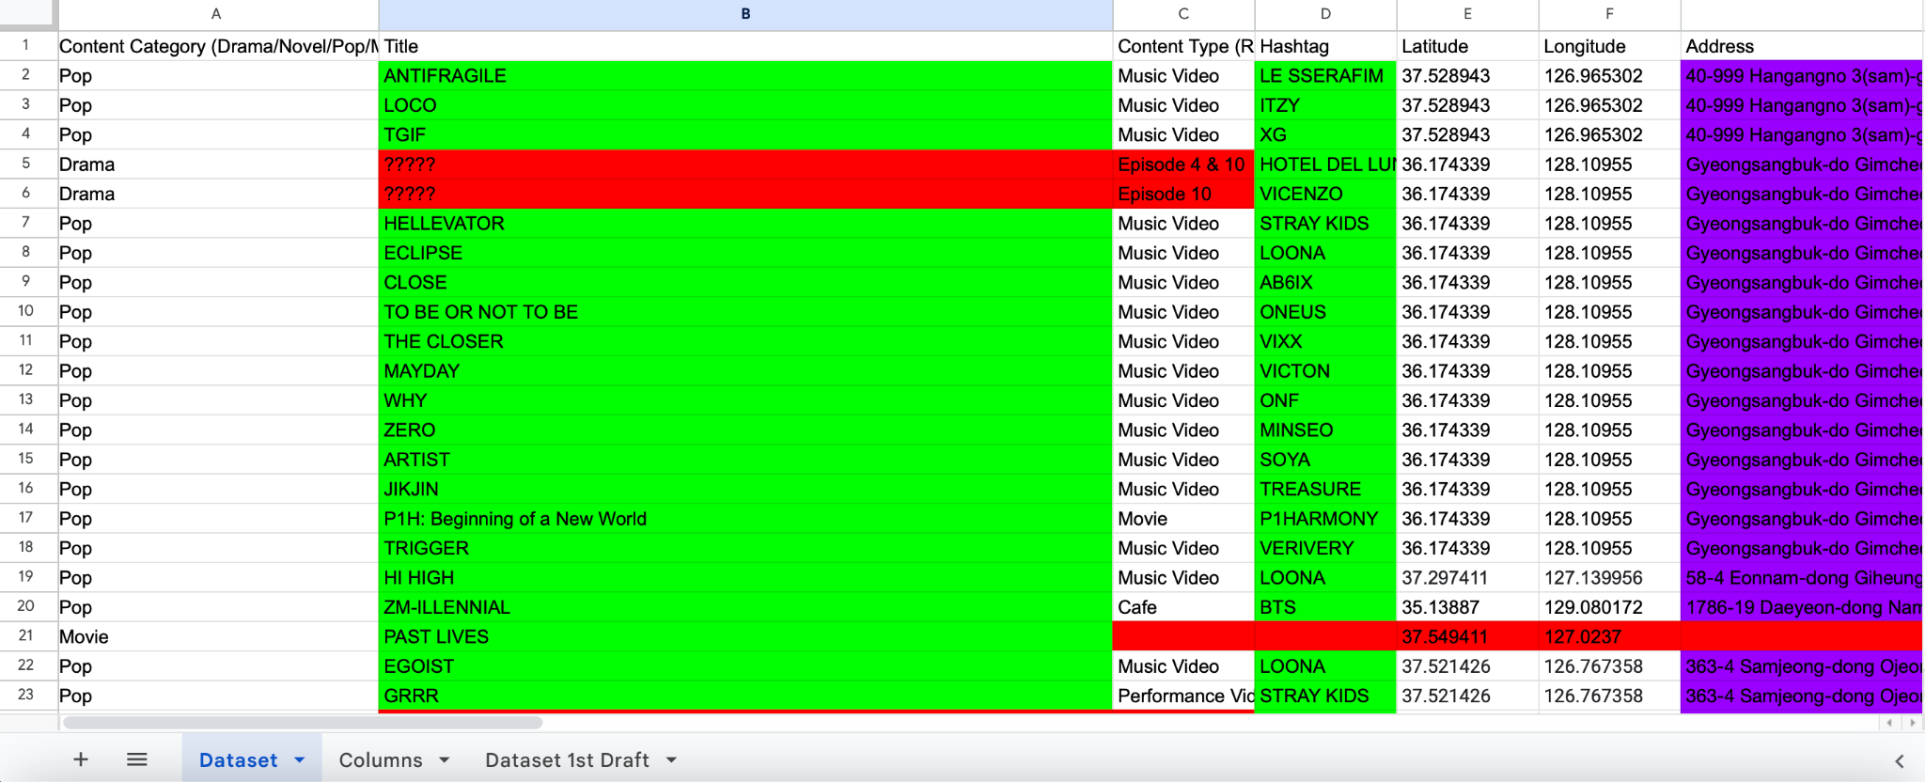
Dataset: Current

Slide 20
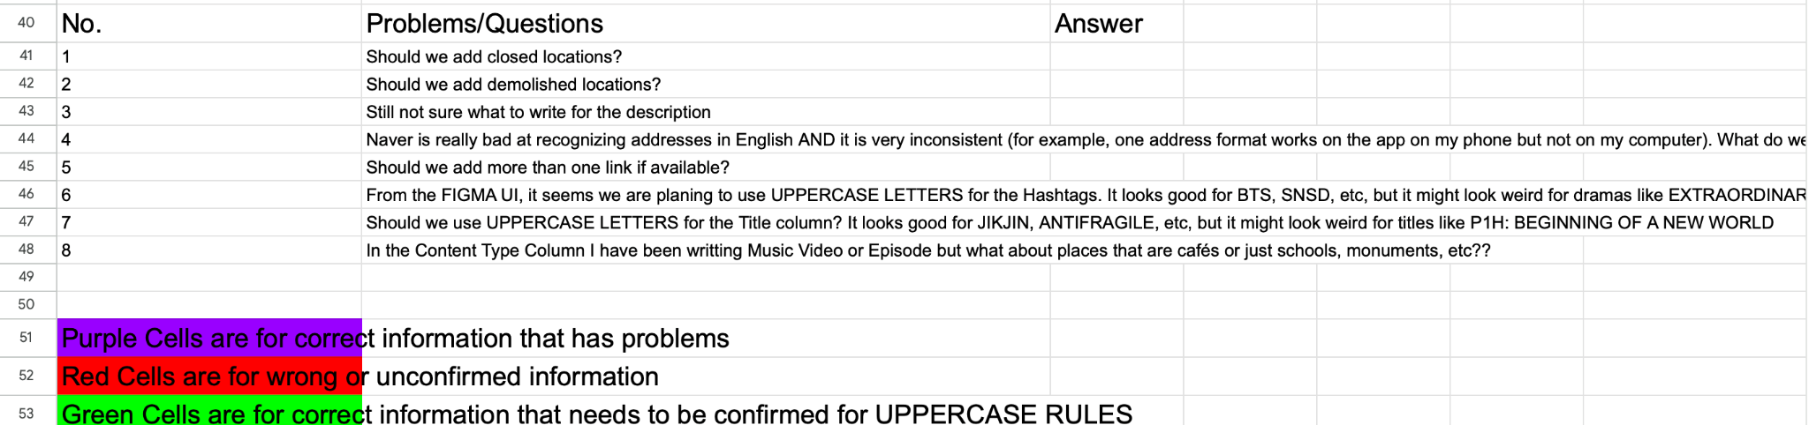
Dataset: Problems & Questions

Slide 21
4
Backend
Notes:
From now on, I’ll explain backend part.

Slide 22
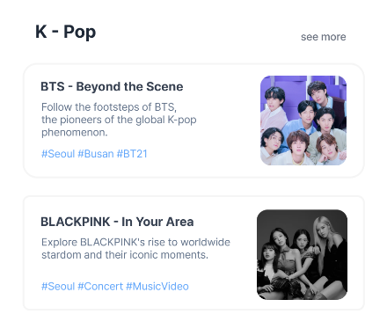
New Column: hashtag
Notes:
First, we added hashtag in each Content.
So, we modified Database schema, DTO, Entity, and test codes for reflecting this change.
콘텐츠를 잘 표현할 수 있는 hashtag 칼럼 추가 -> DB schema, DTO, Entity, test code 등에 반영함.

Slide 23
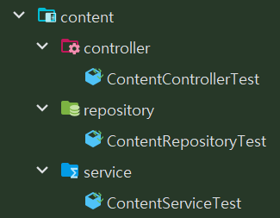
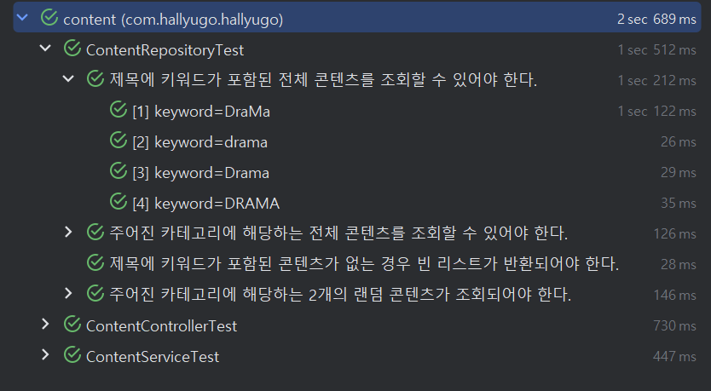
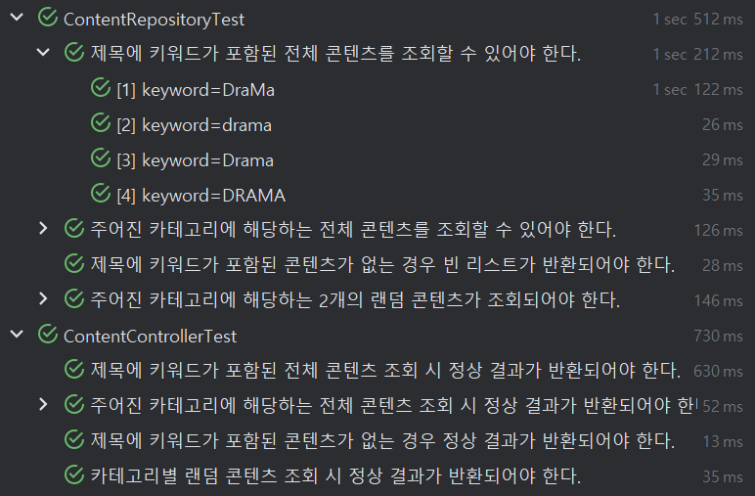
Tests: API to get Content
Notes:
그리고, Content를 조회하는 API에 대한 테스트를 수행했다. 컨트롤러와 리포지토리는 단위 테스트로, 서비스는 통합 테스트로 테스트했다.
And then, I finished testing the API to get Content. The controller and repository were tested as unit test and the service was tested as integration test. Because service layer has to deal with business logic, it is tested by combining other components.

Slide 24
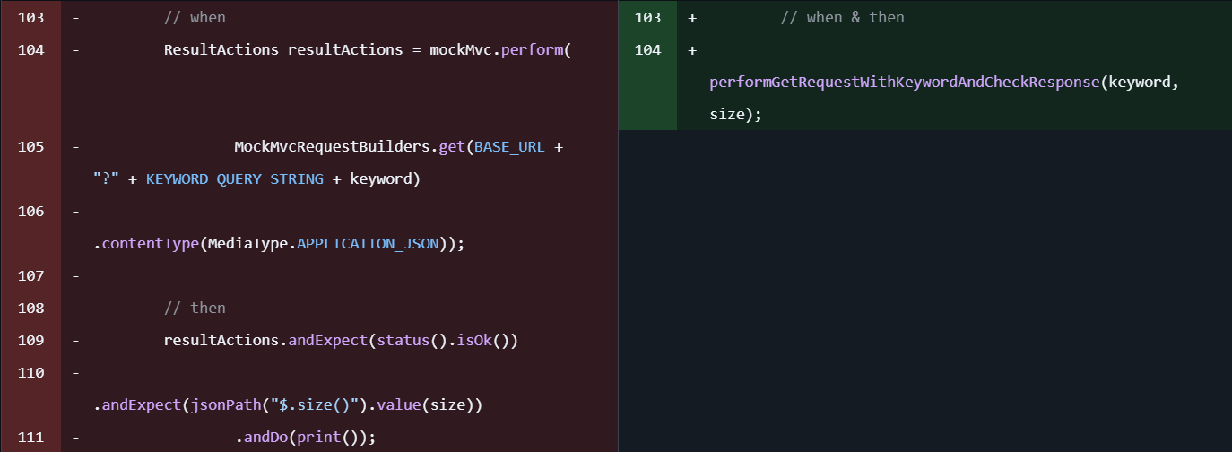
Refactoring: duplicate logic -> method
Notes:
For reusability and readability, I extracted the duplicate logic into one method.

Slide 25
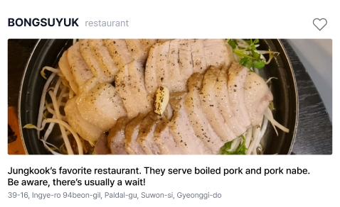
Feature: API for Favorite On/Off
Location has Favorite button
Notes:
In our project, each location has favorite button. So, as the users click or unclick it, we have to handle the favorite count of the button.

Slide 26
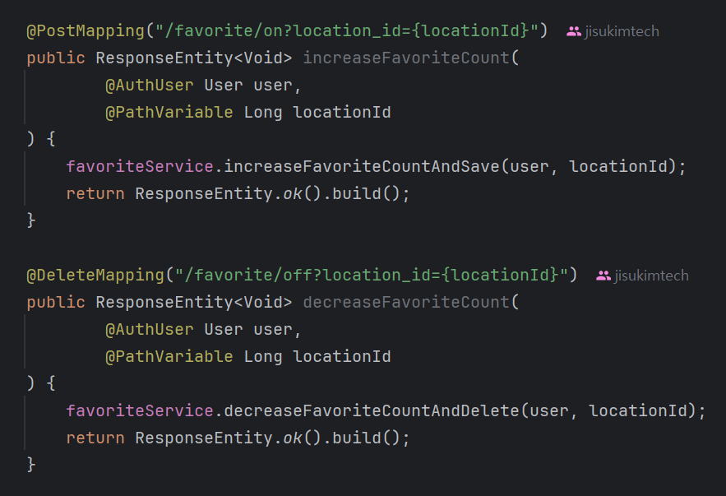
Feature: API for Favorite On/Off
1️⃣POST /api/v1/user/favorite/on?location_id=
Notes:
First, this is the endpoint of api for increasing favorite count when users click it.

Slide 27
Feature: API for Favorite On/Off
2️⃣DELETE /api/v1/user/favorite/off?location_id=
Notes:
Second is the endpoint of api for decreasing favorite count when users unclick it.

Slide 28
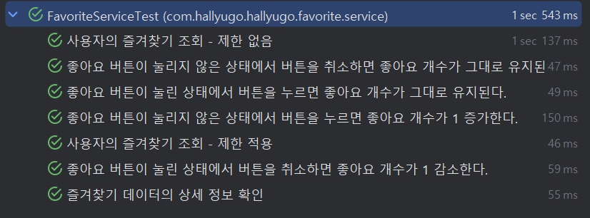
Tests: API for Favorite On/Off
Integration test for Favorite Service
Notes:
Integration test for Favorite service is done. Other tests will be performed soon.

Slide 29
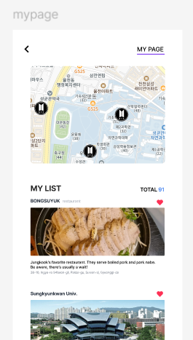
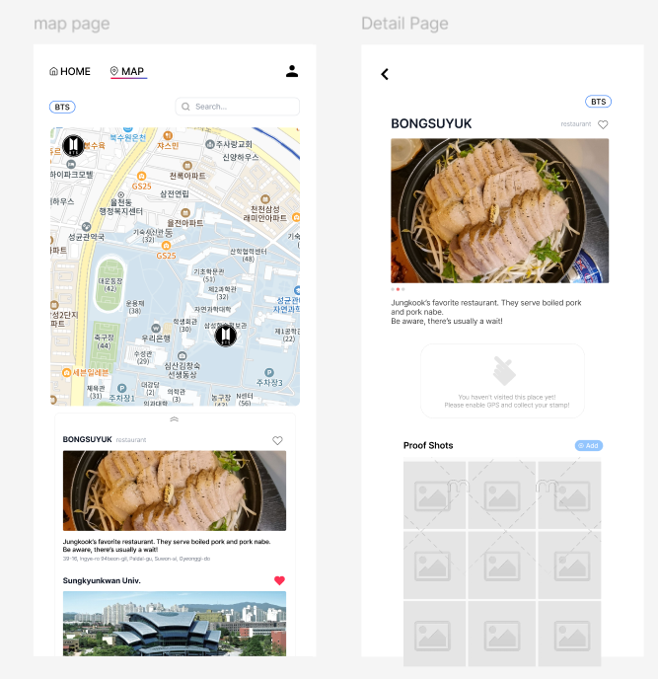
Feature: API for My Page - My List
Notes:
If user click the list item, move to the detail page of the location

Slide 30
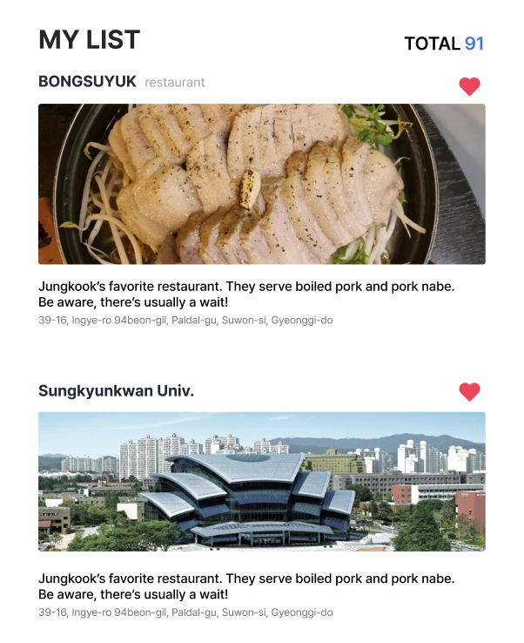
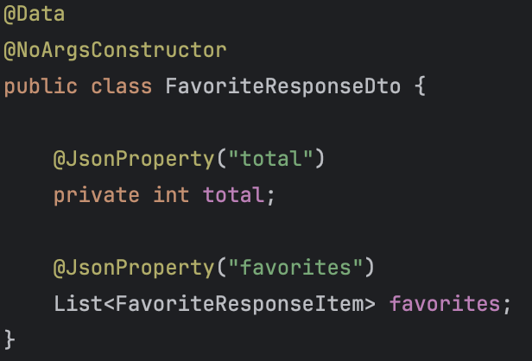
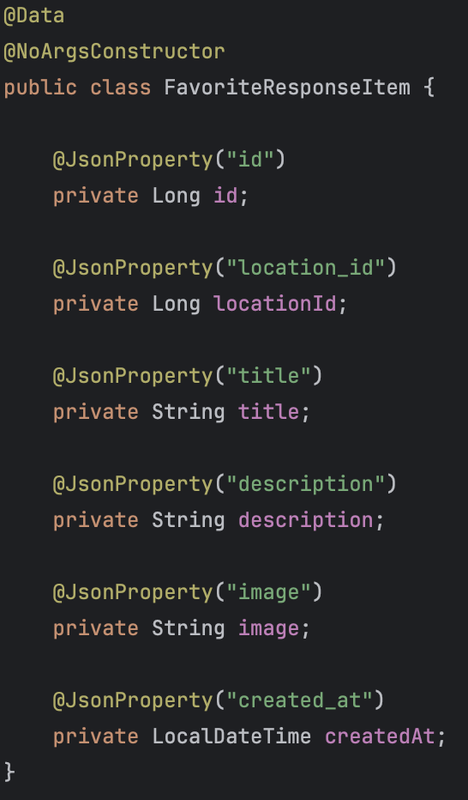
Feature: API for My Page - My List

Slide 31
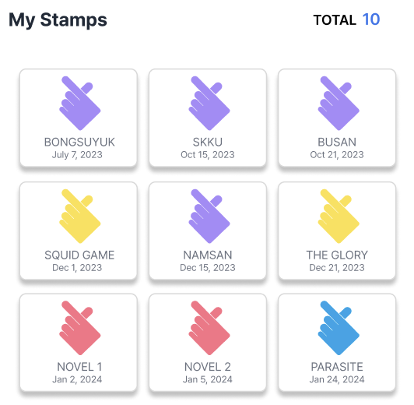
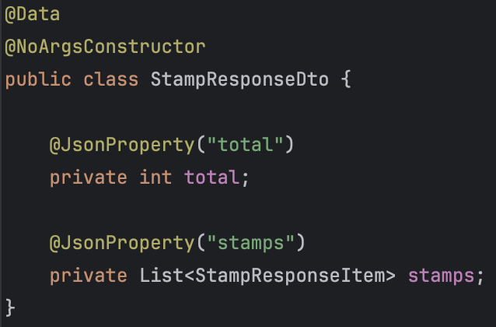
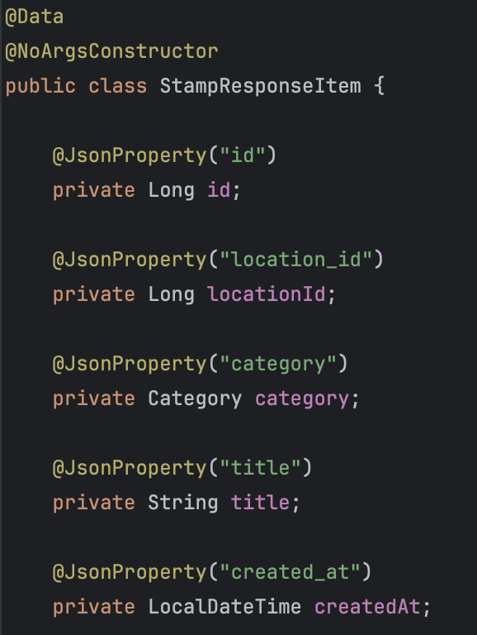
Feature: API for My Page - Stamp

Slide 32

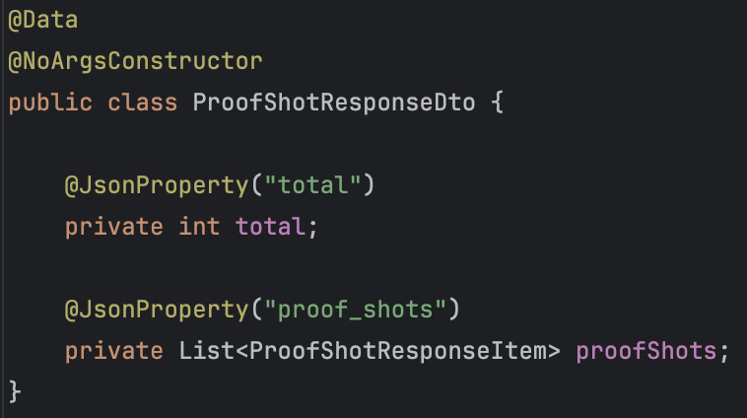
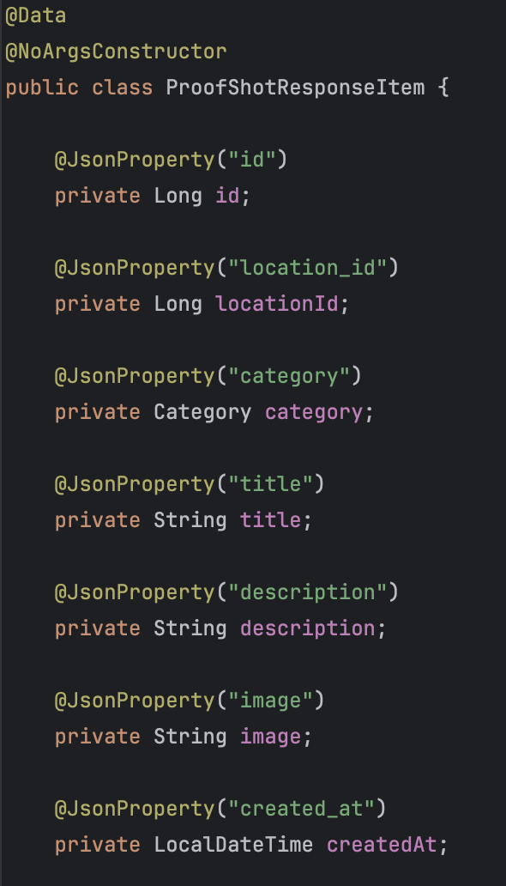
Feature: API for My Page - Proof Shot
Need to save to S3
Notes:
어노테이션의 유효 기간을 지정합니다. RetentionPolicy.RUNTIME으로 설정했기 때문에 런타임 시점까지 이 어노테이션이 유지됩니다.
이렇게 하면 런타임에서 리플렉션을 통해 이 어노테이션을 읽을 수 있습니다. 즉, 애플리케이션 실행 중에도 이 어노테이션을 활용할 수 있습니다.

Slide 33
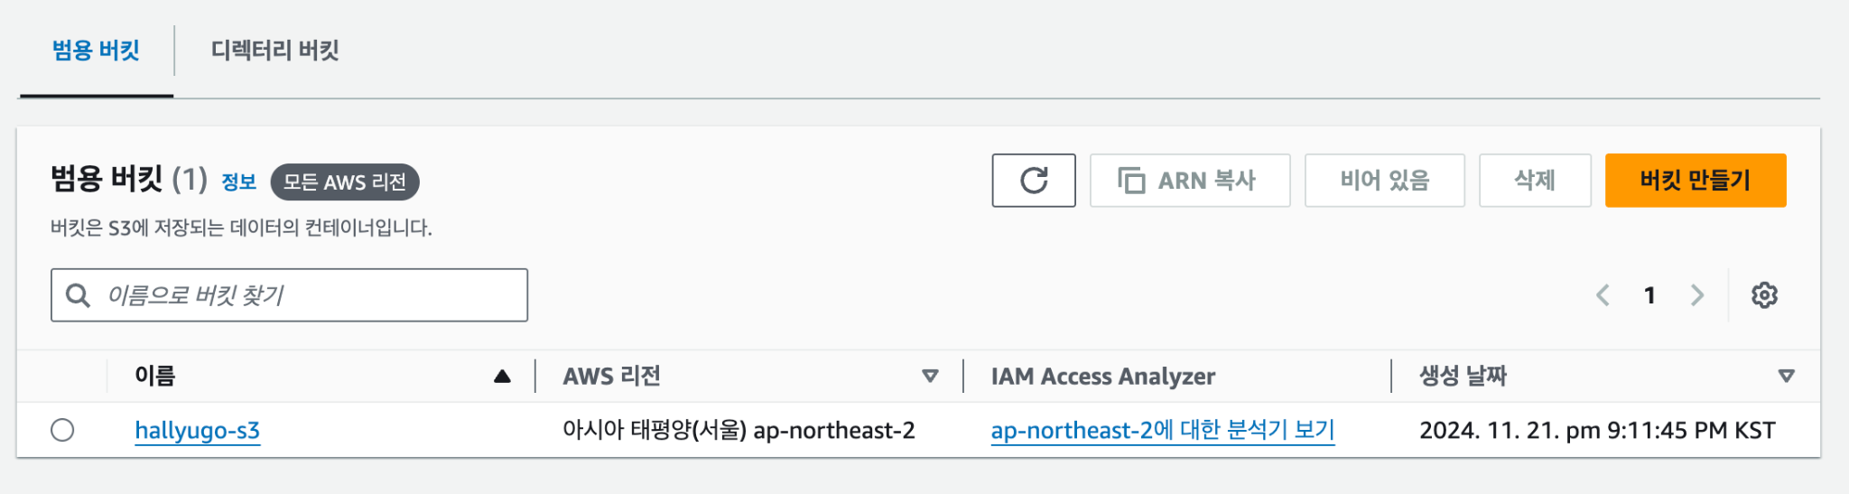
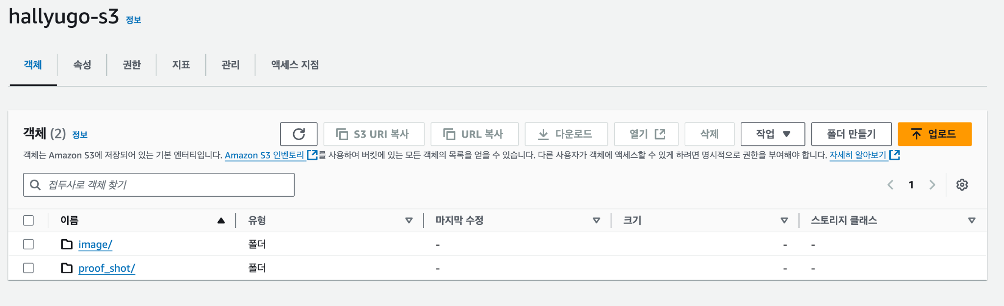
Infra: AWS S3 settings
S3:GetObject S3:PutObject S3:DeleteObject

Slide 34
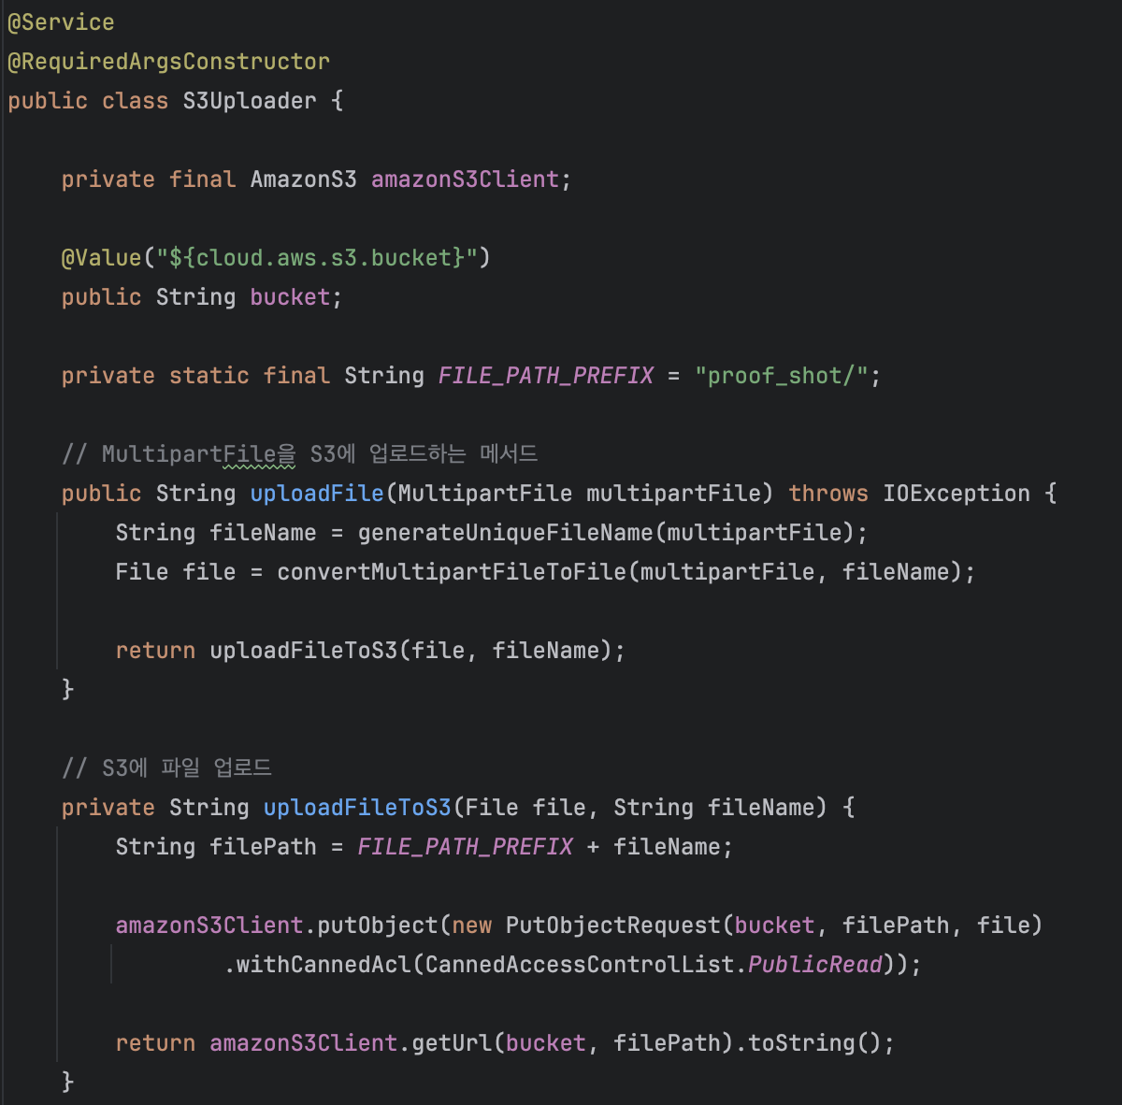
Infra: AWS S3 in Spring
1️⃣Receive a multipartFile
2️⃣Save image in
proof_shot folder in S3
3️⃣Return URL of image

Slide 35
5
Plans

Slide 36
Plans
Name | Role
Daegyo | ProofShot API implementation, AWS settings, CI/CD
YooJin | Naver map API & Detail page API customization
Jose | API connection to Main page & My page
Jisu | Stamp API & Map page API implementation

Slide 37
Thank you
for Listening

